Slide 1
Web Development
Project
2020

Slide 2

Sign In or create an account
Name:
Email ID:
Let’s Start
Password:
Remember Me
Sign In
Already have an account? Login here
Facebook
Twitter
Contact Us

Slide 3
Login
Email ID:
Password:
Let’s Start
Forgot Password?
Login
Need an account? Sign up now!
Facebook
Twitter
Contact Us

Slide 4
Groups
Tests
Assignments
Create a Group
Create Test
Create Assignments
Edit Group
Edit Test
Edit Assignments
Facebook
Twitter
Contact Us

Slide 5
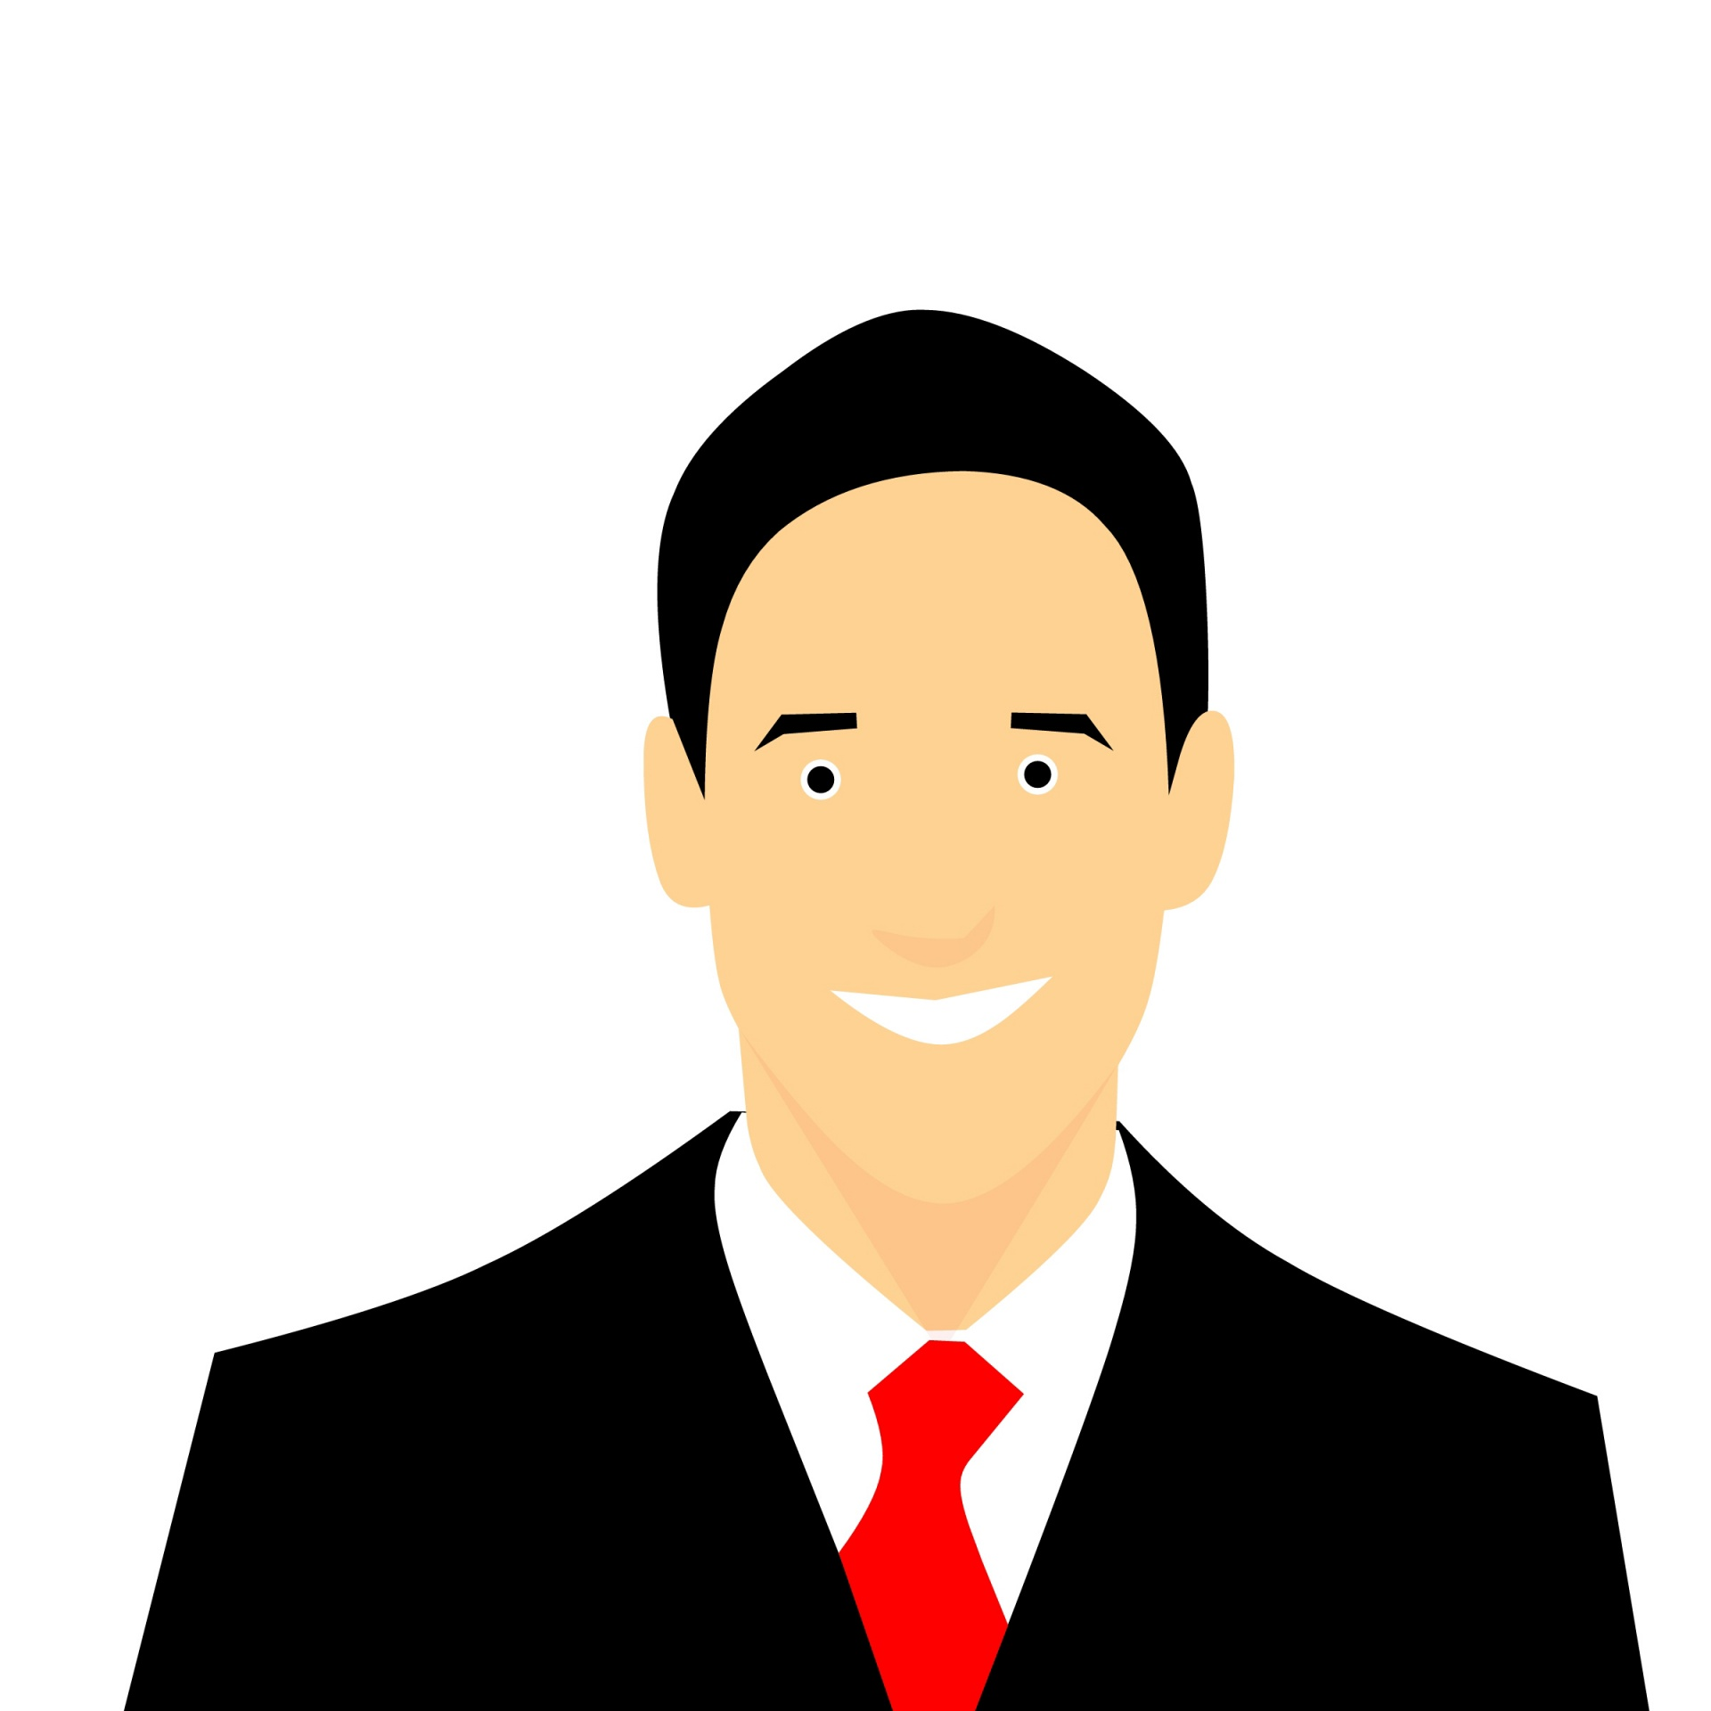
Name
Dashboard
Role : Professor
Help
Will Smith
Courses
Modules
Assessment
Syllabus
Discussion
Calendar
Create Module
Test
People
Quizzes
Edit/Delete Module
Assignments
Classes
Grades
Facebook
Twitter
Contact Us

Slide 6
Create Module
Edit /Delete Module
Facebook
Twitter
Contact Us

Slide 7
Modules > Create Modules
Module Name:
Client Side module
Start
Facebook
Twitter
Contact Us

Slide 8
Modules > Create Modules
Module Name:
Client Side module
Start
Facebook
Twitter
Contact Us

Slide 9
Client-side module
Home
Video A
Edit/Delete
PDF File
Quizzes
Video A
Power Point
Edit/Delete
Grades
Youtube Video
Edit/Delete
People
Server-side module
Pages
PDF File 1
Files
PDF File 2
Video A
PDF File 3
Syllabus
PDF File 4
Discussion
Assignments
Backend Database module
Web page1
Modules
Web page2
Video A
Calendar
Web page3
Web page4
Facebook
Twitter
Contact Us

Slide 10
Tests > Create Test
Test Name:
Midterm Test
Start
Facebook
Twitter
Contact Us

Slide 11

Tests > Create Test > Midterm Test
Title:
Multiple Choice
True False
Matching
Essay
Fill-in-the-blank
Short Answer
Question:
Submit
A
B
C
D
Facebook
Twitter
Contact Us

Slide 12
Tests > Create Test > Midterm Test
Title:
Multiple Choice
True False
Matching
Essay
Fill-in-the-blank
Short Answer
Question:
Submit
Answer:
This is a correct Answer
This is a correct Answer
A
True
B
True
Facebook
Twitter
Contact Us

Slide 13
Tests > Create Test > Midterm Test
Title:
Multiple Choice
True False
Matching
Essay
Fill-in-the-blank
Short Answer
Question:
Match the following:
A
a
B
b
C
c
D
d
Shuffle
Facebook
Twitter
Contact Us

Slide 14
Tests > Create Test > Midterm Test
Title:
Multiple Choice
True False
Matching
Essay
Fill-in-the-blank
Short Answer
Question:
Submit
Answer:
Submit
Facebook
Twitter
Contact Us

Slide 15
Tests > Create Test > Midterm Test
Title:
Multiple Choice
True False
Matching
Essay
Fill-in-the-blank
Short Answer
Question:
Submit
Answer:
Submit
Facebook
Twitter
Contact Us

Slide 16
Tests > Create Test > Midterm Test
Title:
Multiple Choice
True False
Matching
Essay
Fill-in-the-blank
Short Answer
Question:
Submit
Answer:
Submit
Facebook
Twitter
Contact Us

Slide 17
Groups
Tests
Assignments
Create a Group
Create Test
Create Assignments
Edit Group
Edit Test
Edit Assignments
Facebook
Twitter
Contact Us

Slide 18
Assignments > Create Assignments
Assignments Name:
Web Assignment
Start
Facebook
Twitter
Contact Us

Slide 19
Assignments > Edit Assignments
Assignments Name:
Web Assignment
Start
Facebook
Twitter
Contact Us

Slide 20
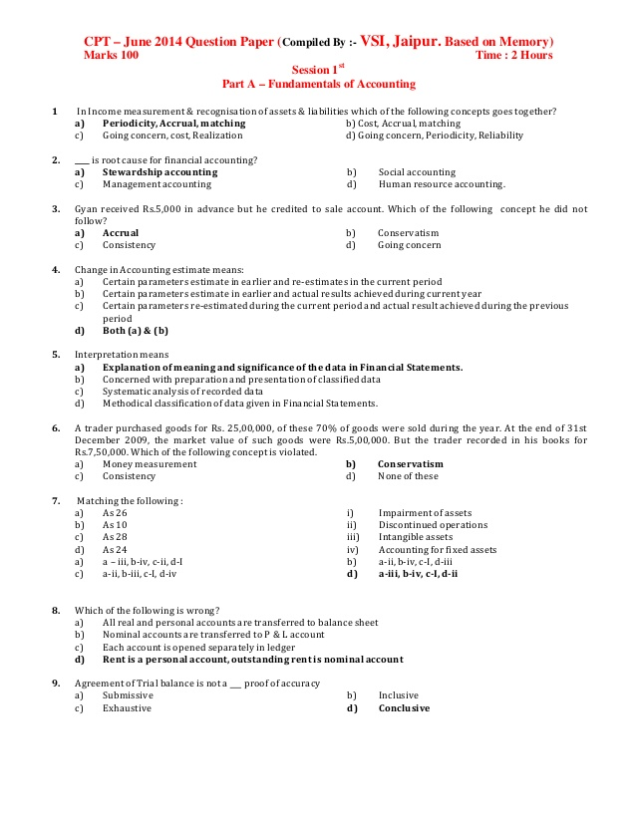
Assignments > Edit Assignments
Home
Quizzes
Grades
People
Pages
Files
Syllabus
Discussion
Assignments
Modules
Calendar
Submit
Submit
Facebook
Twitter
Contact Us

Slide 21
Grades
CSIT
Web Development
Midterm
Home
Program Name
Course Name
Test Name
Quizzes
Grades
100
Total marks
People
Pages
Student | Score | Certificate
Jhon | 85 | Created
Files
Syllabus
Discussion
Assignments
Modules
Calendar
Submit
Exit
Facebook
Twitter
Contact Us

Slide 22
How XYZ works
How XYZ works
How XYZ works
Facebook
Twitter
Contact Us

Slide 23
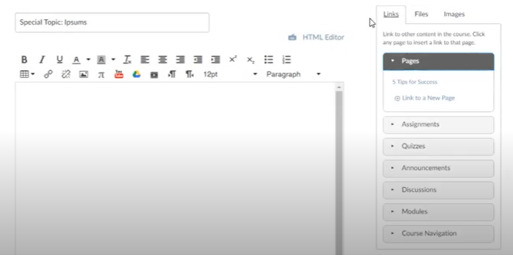
Client-side module
Client-side module
Home
Quizzes
ADD
Grades
People
Pages
Files
Syllabus
Discussion
Assignments
Modules
Calendar
Submit
Facebook
Twitter
Contact Us

Slide 24
Client-side module
Home
Video A
PDF File
Quizzes
Video A
Power Point
Grades
Youtube Video
People
Server-side module
Pages
PDF File 1
Files
PDF File 2
Video A
PDF File 3
Syllabus
PDF File 4
Discussion
Assignments
Backend Database module
Web page1
Modules
Web page2
Video A
Calendar
Web page3
Web page4
Facebook
Twitter
Contact Us

Slide 25
THANK YOU

Slide 26
Note: There may be same changes we have done in prototype during the development process which is not included in this documents.

